Slide 1

Name– Rishabh Jain Registration no. – 12211778 Section– K22DM
Course – Interaction Design

Slide 2
Content
CA-1 (User Research)
CA-2
CA-3(Low Fidelity)
CA-4(High Fidelity)

Slide 3
CA-1

Slide 4
E-commerce Overview
E-commerce, the practice of conducting business transactions over the internet, has drastically changed how consumers purchase goods and services. This model allows customers to shop online at any time, without needing to visit a physical store. E- commerce has grown rapidly, with companies of all sizes offering products online, from large corporations to small businesses. It includes various forms of transactions, like business- to-consumer (B2C), business-to-business (B2B), and consumer-to- consumer (C2C). The expansion of e-commerce has been fueled by technological advancements, making it easier for businesses to reach customers and for customers to find what they need online.

Slide 5
The Clothing Niche in E-commerce
Within the broad landscape of e-commerce, the clothing sector stands out as particularly dynamic. Clothing is a basic necessity, but it also plays a significant role in personal expression and fashion trends. This niche covers a vast range of categories, including casual wear, formal attire, sportswear, and specialized clothing like eco-friendly or custom- made garments. Online clothing stores have the advantage of showcasing a wide variety of styles and sizes, offering something for everyone. However, the competitivenature of the market means that brands must continually innovate to stay relevant and attract customers.

Slide 6
Problem Statement:
High Return Rates Due to Sizing Issues: A common issue faced by online clothing retailers is the high rate of product returns, often due to sizing problems.
Payment Problems: Complicated or untrustworthy payment gateways are a significant concern. Users may encounter issues with payment
processing, lack of preferred payment options, or concerns about security.
Transaction Security: Ensuring customer confidence in the security of their transactions on the platform.
Customer Support: Addressing effectiveness and responsiveness of customer support services.

Slide 7
Appendix: Survey Questions and Supporting Data
Below are the survey questions designed to gather insights into customer preferences, behaviors, and satisfaction with the online clothing shopping experience. Each question is followed by a detailed analysis that identifies key trends and areas for improvement. Accompanying charts and graphs visually represent the data, offering a clear summary of the findings. These visuals highlight important patterns, supporting the conclusions and recommendations in this report.

Slide 8
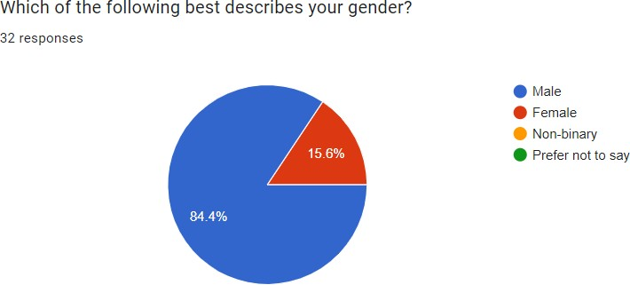
1) Understanding gender distribution among users allows for tailored marketing, product offerings, and user experiences.

Slide 9
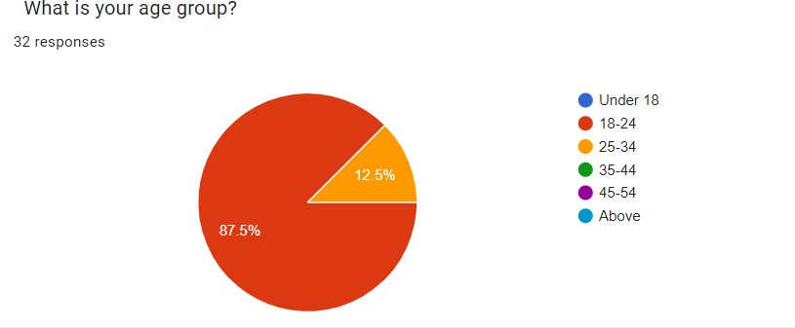
2) It reveals that individuals aged 18-24 are more actively engaged in online clothing shopping.

Slide 10
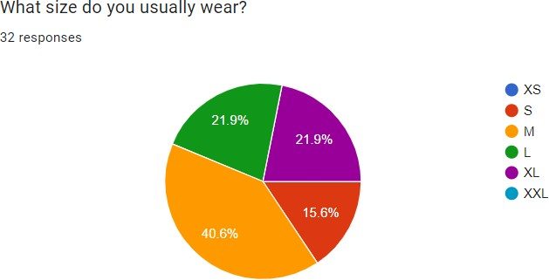
3) This insight helps align stock levels with customer needs, ensuring popular sizes are well- stocked. It also reduces return rates by improving size accuracy.

Slide 11
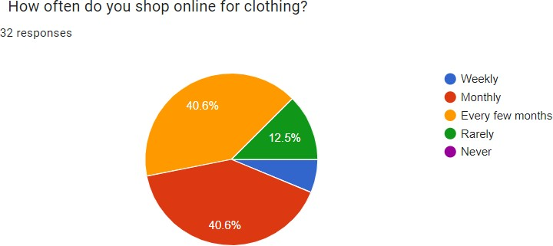
4) It indicates how frequently customers shop online, helping to gauge their engagement levels. It allows the website to tailor marketing efforts and loyalty programs to boost customer retention and repeat purchases.

Slide 12
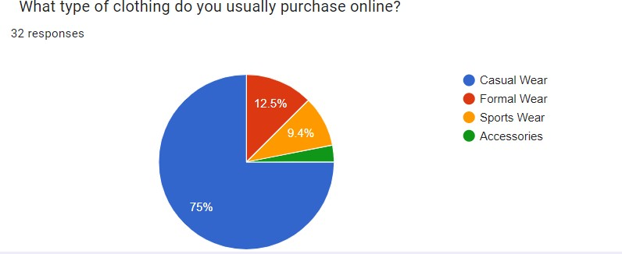
5) This question identifies the types of clothing customers prefer online, aiding in inventory optimization and targeted marketing.

Slide 13
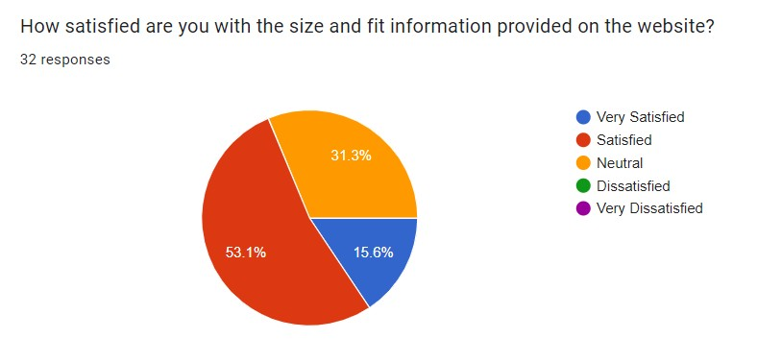
Navigating Your Online Shopping Journey
6) This question gauges how well sizes match customer expectations. High satisfaction suggests accurate sizing, while low satisfaction indicates potential issues with fit accuracy.

Slide 14
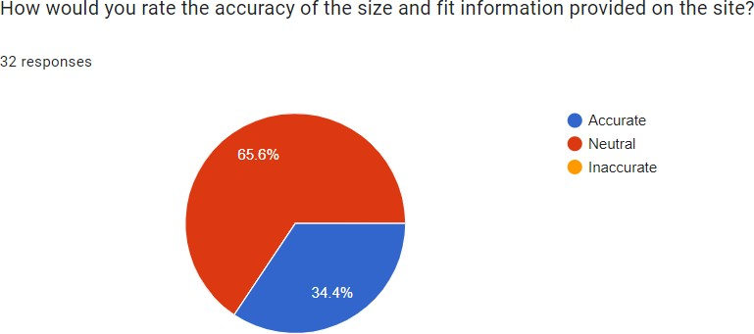
7) This question assesses customers' perceptions of the accuracy of product descriptions and sizing. High ratings indicate reliable details, while low ratings suggest discrepancies that need improvement.

Slide 15
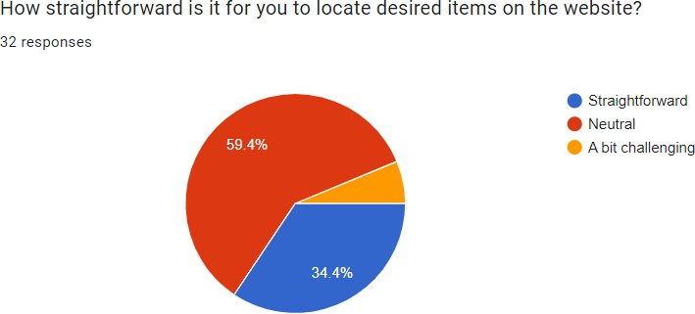
8) This question measures how easily customers can find items on the website. High ratings indicate a user-friendly interface, while low ratings suggest potential navigation or search issues.

Slide 16
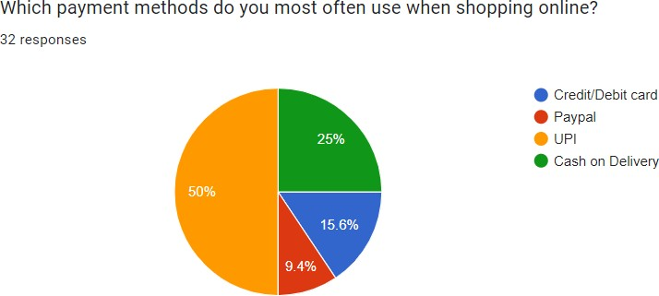
9) This question identifies the most commonly used payment methods. Insights can guide the website in offering preferred payment options and enhancing the checkout experience

Slide 17
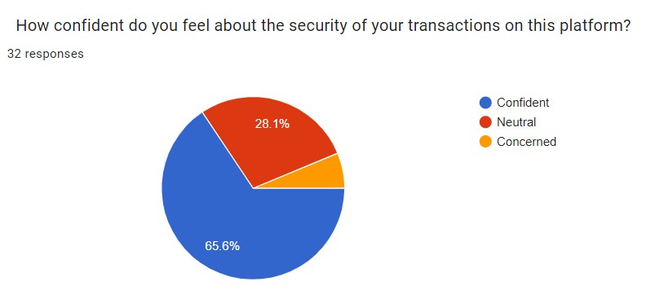
10) This question measures customer confidence in transaction security. High confidence suggests strong security measures, while low confidence points to areas for improvement.

Slide 18
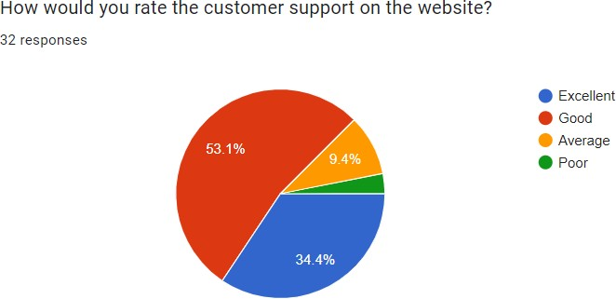
Customer Satisfaction Insights
11) This question evaluates customers' perceptions of website customer support. High ratings suggest effective assistance, while low ratings highlight areas needing improvement in service quality.

Slide 19
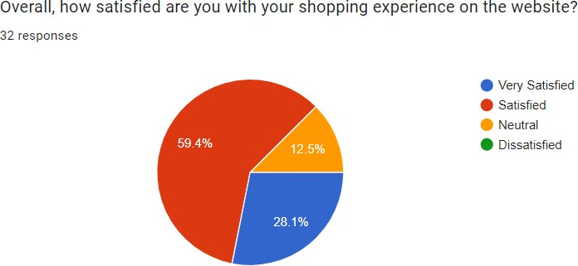
12) This question measures overall satisfaction with shopping experience. High satisfaction indicates positive experience, while low satisfaction points to areas needing improvement.

Slide 20
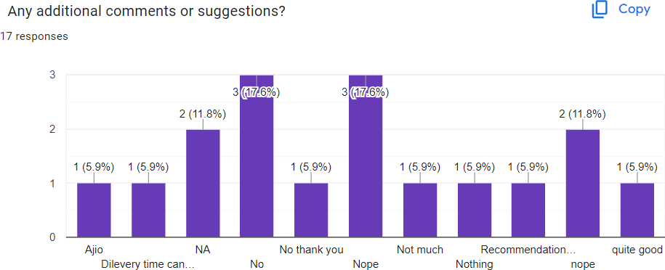
Actionable Insights: Highlight any specific areas where immediate action could be taken to enhance the shopping experience or address recurring issues.

Slide 21
Solutions to Address the Problem
Enhance Website Usability: Streamline navigation and improve search functionality to help customers easily find desired items.
Optimize Product Information: Ensure accurate descriptions and sizing information to match customer expectations and reduce discrepancies.
Expand Payment Options: Offer a variety of payment methods to cater to different customer preferences.
Strengthen Security Measures: Implement robust security protocols to increase customer confidence in transaction safety.
Improve Customer Support: Provide timely and effective assistance to address customer queries and issues efficiently.

Slide 22
Tactics for Success
Personalized Shopping Experience: Use customer data to tailor recommendations, making it easier for shoppers to find clothing that suits their size and style preferences.
Collaborations with Influencers: Partner with fashion influencers who can demonstrate how your clothing fits and looks, offering their audience a real- life perspective that can reduce hesitancy in purchasing.
Highlight Popular Items: Showcase bestsellers and highly-rated products to build trust and encourage purchases based on the popularity and positive feedback of these items.
Use AI Chat Support: Implement AI chat support to assist customers in real-time, helping them with size-related queries and providing instant recommendations.

Slide 23
Conclusion
The survey insights reveal crucial areas for enhancing the online shopping experience in the clothing segment. Understanding gender distribution, age engagement, size preferences, and shopping frequency helps tailor inventory and marketing strategies effectively. Addressing issues related to size fit accuracy, payment methods, and website navigation can significantly improve customer satisfaction. Ensuring robust security measures and responsive customer support.

Slide 24
CA-2

Slide 25









Slide 26










•
•
•
•
•
•
•

Slide 27
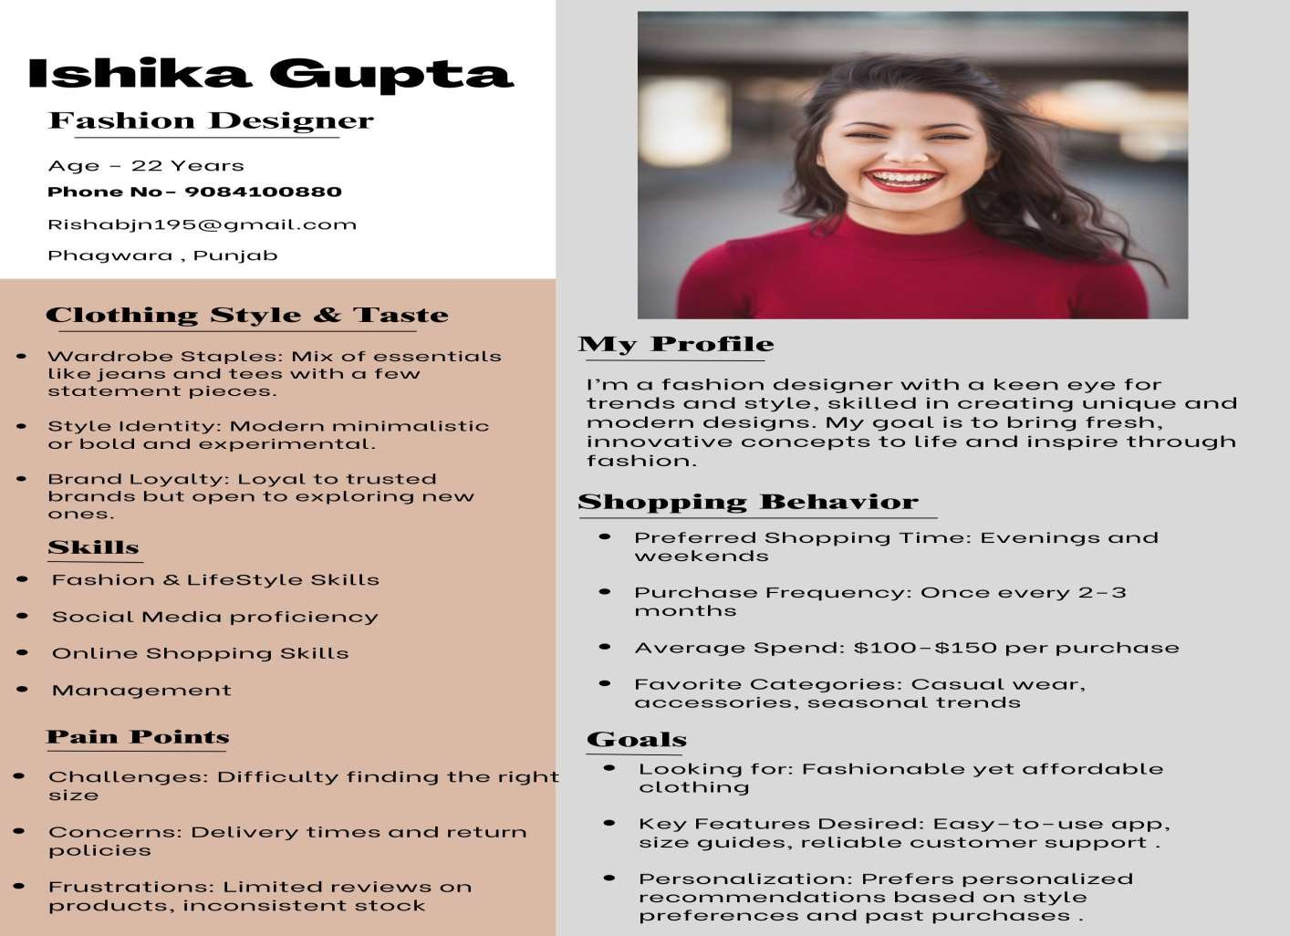


Slide 28

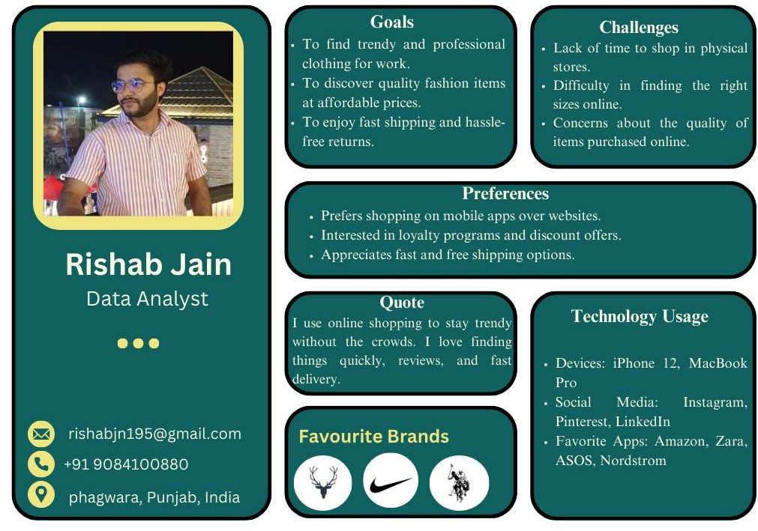

Slide 29




















































































































•
•
•
•
•
•
•
•
•
•
•
•
•
•
•
•
•
•
•

Slide 30
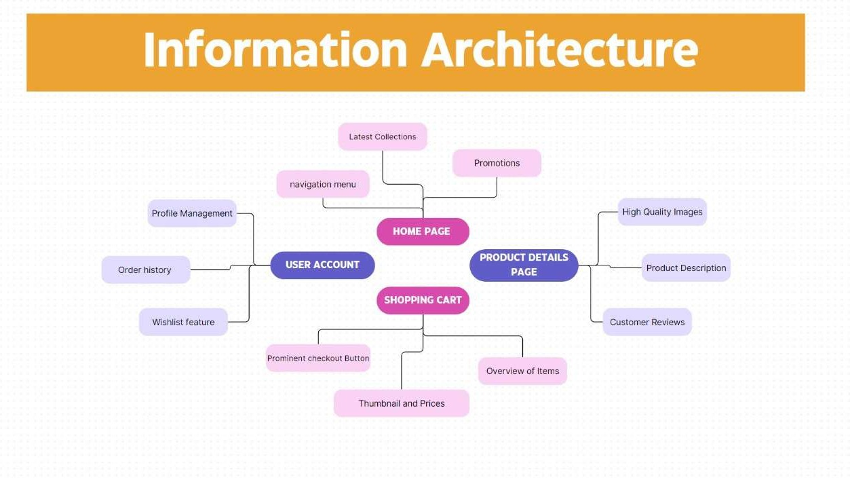

Slide 31
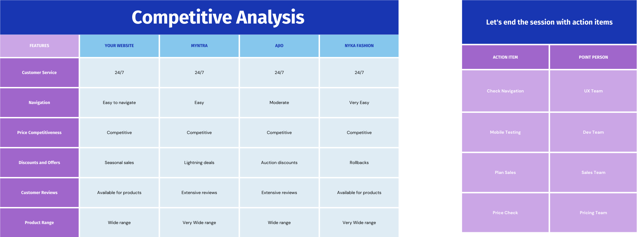

Slide 32















•
•
•
•
•
•

Slide 33
CA-3

Slide 34




Slide 36





Slide 37



Slide 38




Slide 39



Slide 40



Slide 41







Slide 42





Slide 43






Slide 44





Slide 45








Slide 46







Slide 47





Slide 48






Slide 49



Slide 50
CA-4

Slide 51







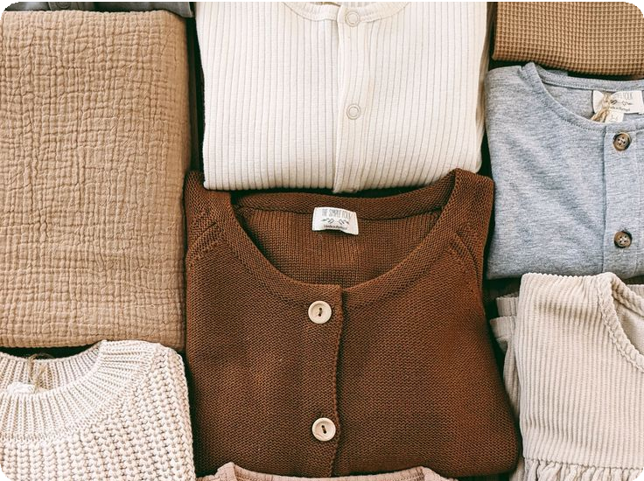

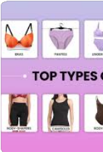


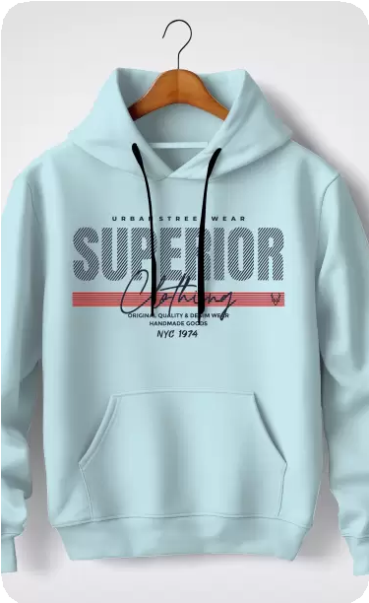


Slide 52









Slide 53




Slide 54


Slide 55






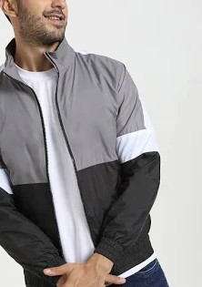

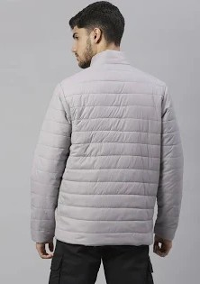
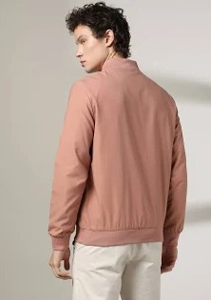

Slide 56





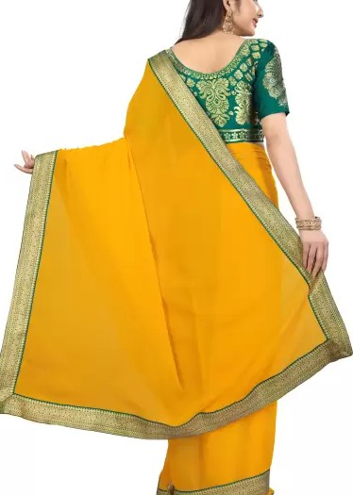

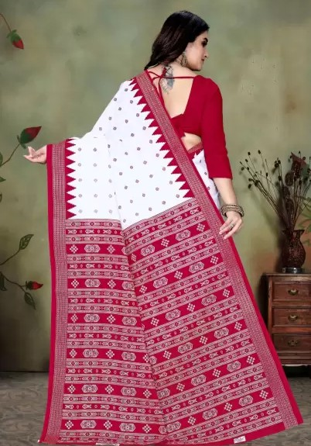


Slide 57


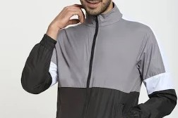








Slide 58











Slide 59







Slide 60








Slide 61





Slide 62









Slide 63






Slide 64
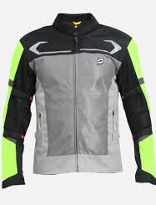
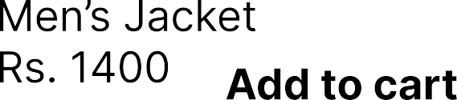




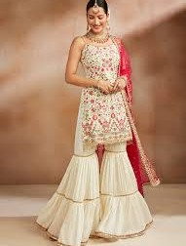
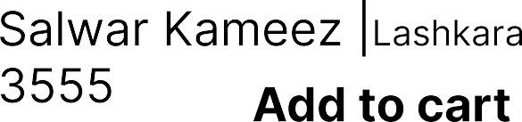

Slide 65











Slide 66




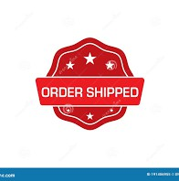








Slide 67
Thank You

